Slide 1
Soft computing part 2 Particle swarm optimization
Arnaldo Sepulveda

Slide 2
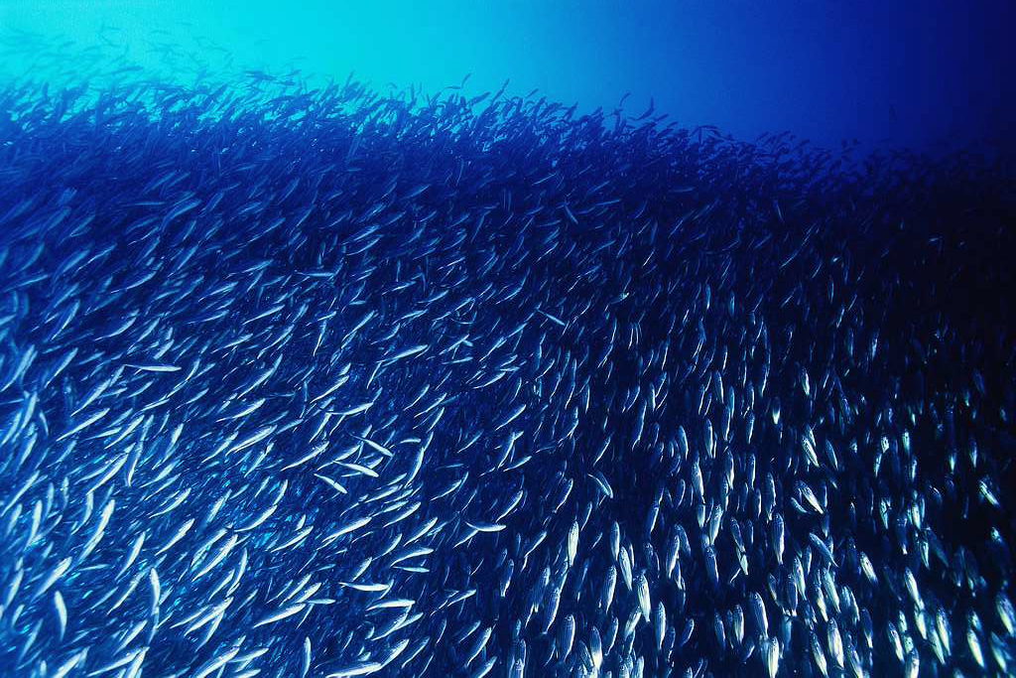
Swarm intelligence

Slide 3
Swarm intelligence
Swarm intelligence (SI) is an artificial intelligence technique based around the study of collective behavior in decentralized, self-organized systems
SI systems are typically made up of a population of simple agents interacting locally with one another and with their environment
Normally no centralized control structure dictating how individual agents should behave, local interactions between such agents often lead to the emergence of global behavior
Examples found in nature:ant colonies, bird flocking

Slide 4
Swarm intelligence
Human intelligence results from social interaction:
Evaluating, comparing, and imitating one another, learning from experience and emulating the successful behaviors of others, people are able to adapt to complex environments through the discovery of relatively optimal patterns of attitudes, beliefs, and behaviors (Kennedy & Eberhart, 2001)

Slide 5
Swarm intelligence
Culture and cognition are inseparable consequences of human sociality:
Culture emerges as individuals become more similar through mutual social learning
The sweep of culture moves individuals toward more adaptive patterns of thought and behavior

Slide 6
Particle Swarm Optimization
As described by the inventers James Kennedy and Russell Eberhart, “particle swarm algorithm imitates human (or insects) social behavior. Individuals interact with one another while learning from their own experience, and gradually the population members move into better regions of the problem space”
A demo: http://www.red3d.com/cwr/boids/

Slide 7
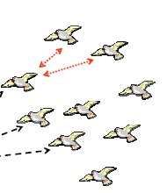
Particle Swarm Optimization
Why named as “Particle”, not “points”?
Both Kennedy and Eberhart felt that velocities and accelerations are more appropriately applied to particles

Slide 8
Its links to Evolutionary Computation
Both PSO and EC are population based
PSO also uses the fitness concept, but, less-fit particles do not die. No “survival of the fittest”
No evolutionary operators such as crossover and mutation
Each particle (candidate solution) is varied according to its past experience and relationship with other particles in the population
Having said the above, there are hybrid PSOs, where some EC concepts are adopted, such as selection, mutation, etc.

Slide 9
Particle Swarm Optimization
Maintain useful information (memory)
Ability to adapt to a changing environment
Better chance to find global solution
Personal and Social (group) influence (experience)

Slide 10
Structure of PSO and BPSO
Michael Angelo A. Pedrasa, Scheduling of Demand Side Resources Using Binary Particle Swarm Optimization

Slide 11
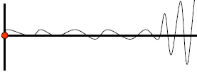
Parameters
To prevent it to explode, the parameter Vmax is used
If the velocity value exceeds ±Vmax, it gets reset to ±Vmax accordingly

Slide 12
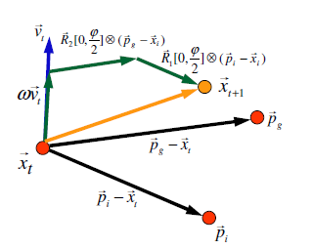
Visualizing PSO

Slide 13
Communication topologies
Two most common models:
gbest: each particle is influenced by the best found from the entire swarm.
lbest: each particle is influenced only by particles in local neighborhood.

Slide 14
Steps
Step 1: Generate an initial population with randomly generated particles
Step 2: Evaluate all particle individuals in the population
Step 3: Sort all particles in descending order of their fitness values (i.e., from the best-fit to least-fit ones)
Step 4: Determine the species seeds for the current population
Step 5: Assign each species seed identified as the to all individuals identified in the same species
Step 6: Adjusting particle positions according to the PSO velocity and position update equation (1) and (2)
Step 7: Go back to step 2), unless termination condition is met

Slide 15
Why PSO?
With a population of candidate solutions, a PSO algorithm can maintain useful information about characteristics of the environment
PSO, as characterized by its fast convergence behavior, has an in-built ability to adapt to a changing environment
Some early works on PSO have shown that PSO is effective for locating and tracking optima in both static and dynamic environments

Slide 16
Issues
Two major issues must be resolved when dealing with dynamic problems:
How to detect that a change in the environment has actually occurred?
How to respond appropriately to the change so that the optima can still be tracked?

Slide 17
Pareto Front
Pareto efficient situations are those in which it is impossible to make one person better off without necessarily making someone else worse off.
Identifying the Pareto Front from a set of points in a multi-objective space is the most important and also the most time-consuming task in multi-objective optimization
Xiaodong Li, School of Computer Science and IT, RMIT University, Melbourne, Australia

Slide 18
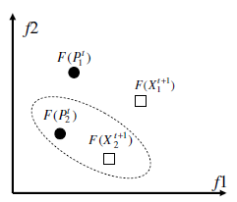
Concept of domination
A solution vector x is said to dominate the other solution vector y if the following 2 conditions are true:
The solution x is no worse than y in all objectives
The solution x is strictly better than y in at least one objective

Slide 19
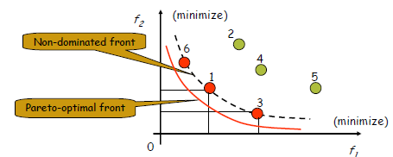
Concept of domination
Solution 1 and 3 are non-dominated with each other
Solution 6 dominates 2, but not 4 or 5.

Slide 20
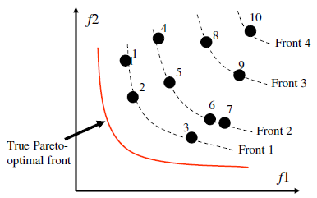
Non-dominated Sorting PSO
Selection pressure towards the true Pareto-optimal front

Slide 21
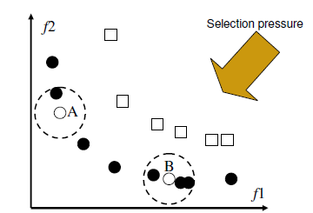
Niching techniques
A will be preferred over B, since A has a smaller niche count than B

Slide 22
PSO for Multiobjective Optimization
Two major goals in multiobjective optimization:
To obtain a set of non-dominated solutions as closely as possible to the true Pareto front
To main a well-distributed solution set along the Pareto front

Slide 23
Constraint Handling
The most common approach for solving constrained problems is the use of a penalty function
The constrained problem is transformed into an unconstrained one, by penalizing the constraints and creating a single objective function

